Slide 1
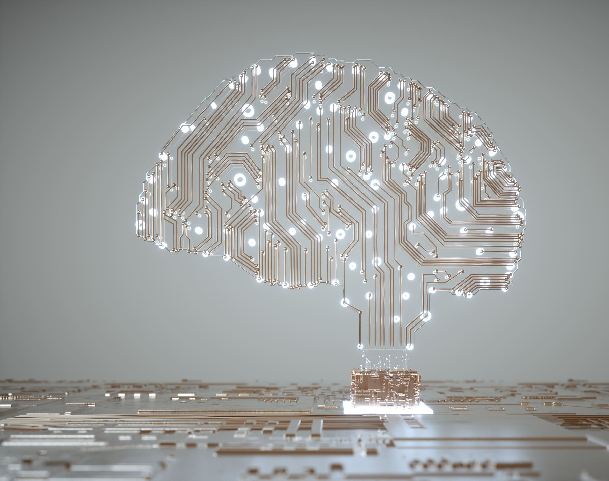
Applied Artificial Intelligence in Toxicology
Marc A.T. Teunis, PhD,
Associate professor,
University of Applied Sciences, Utrecht
The Netherlands

Slide 2
Contents
introduction to machine learning
How do we practically build machine learning models?
AI in Toxicology - Examples
hands-on example with tidymodels in R

Slide 3

Introduction to machine learning

Slide 4
Artificial Intelligence
AI
"intelligent agents": any system that perceives its environment and takes actions that maximize its chance of achieving its goals.
Input -> Action -> Goal
ML
NLP
DL
GA
AI: Artificial Intelligence; ML: Machine Learning; DL: Deep Learning;
NLP: Natural Language Processing; GA: Graph Algorithms

Slide 5
Machine learning
In machine learning, the ‘machine’ is presented with examples relevant to the task and needs to figure out the rules.
Rules
Classical programming for problem solving
Answers
Data
Data
Machine Learning
Rules
Answers
Adapted from Deep Learning with R, Cholet & Allaire, 2019
Notes:
Many of the classical statistical approaches are build according the first box. ML is fundamentally different because there is no direct instruction on how the problem needs to be solved. Only the data and the expected outcome are provided, the algorithm figures out the set of rules to arrive at new answers when new data (not seen before) are presented.

Slide 6
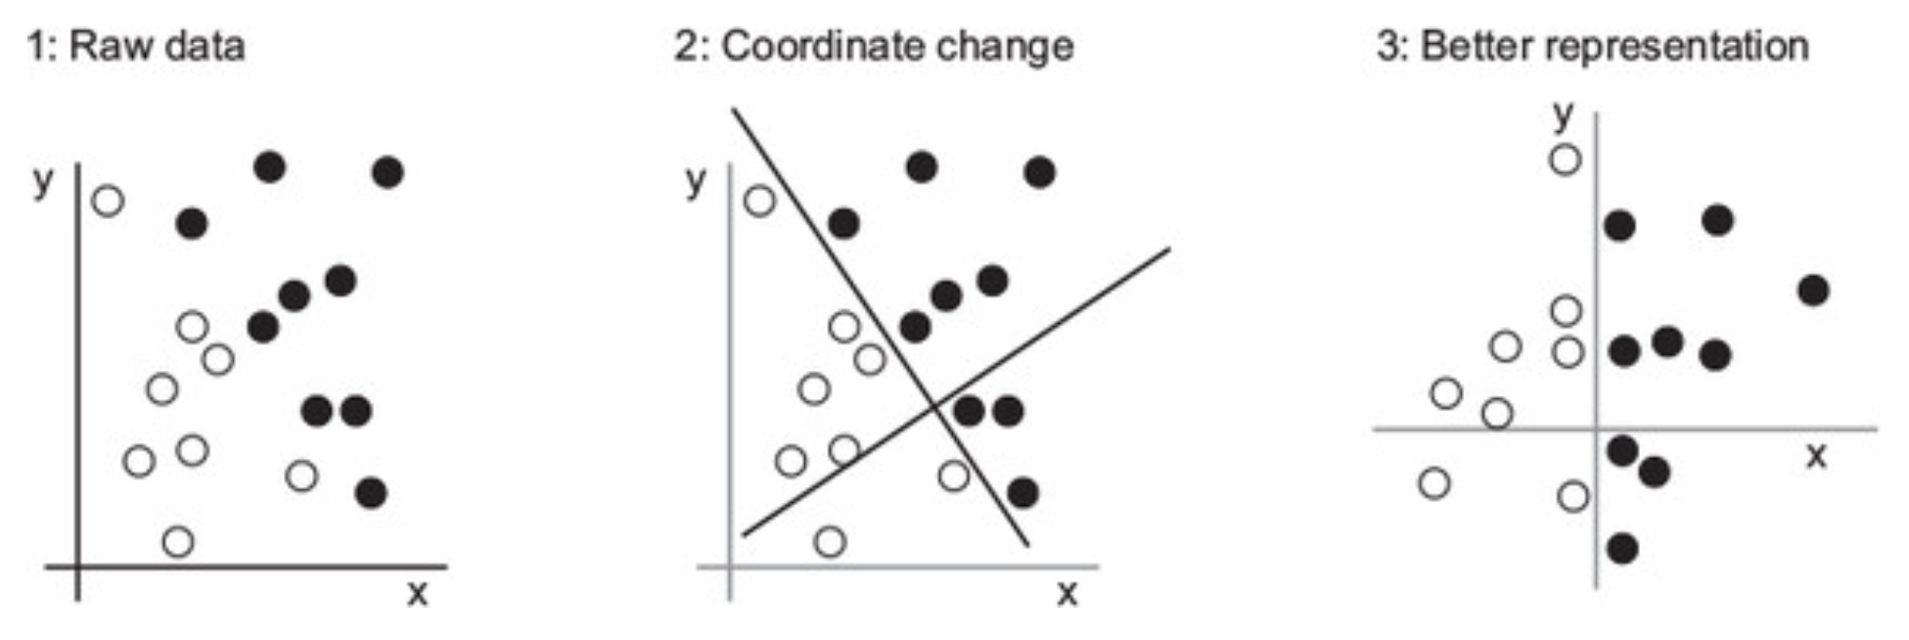
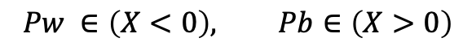
Elementary algorithm
Construct an algorithm that can classify a dot for class ‘white’ or ‘black’
$$Pw ∈\left(X<0\right), Pb∈\left(X>0\right)$$
Example adapted from Deep Learning with R, Cholet & Allaire, 2019
Notes:
All machine-learning algorithms consist of automatically finding such transformations that turn data into more-useful representations for a given task. These operations can be coordinate changes, as you just saw, or linear projections (which may destroy information), translations, nonlinear operations (such as “select all points such that x > 0”), and so on. Machine-learning algorithms aren’t usually creative in finding these transformations; they’re merely searching through a predefined set of operations, called a hypothesis space.
So that’s what machine learning is, technically: searching for useful representations of some input data, within a predefined space of possibilities, using guidance from a feedback signal. This simple idea allows for solving a remarkably broad range of intellectual tasks, from speech recognition to autonomous car driving.
Now that you understand what we mean by learning, let’s take a look at what makes deep learning special.

Slide 7



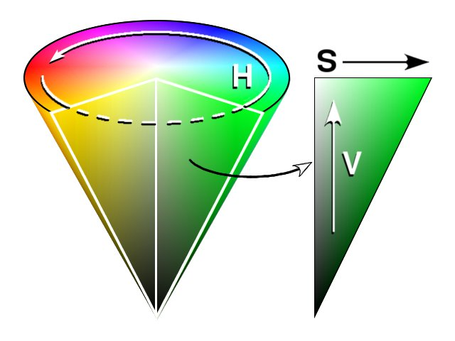
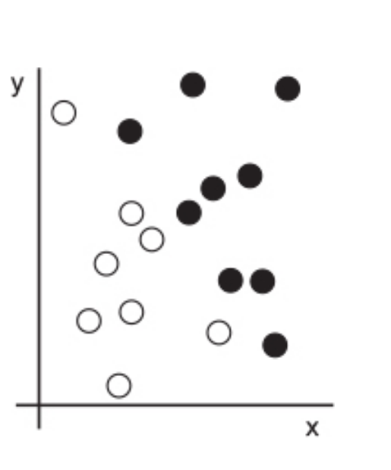
What do we need for machine learning?
Classify pictures that contain much green
Machine learning algorithm
RGB
Optimize the amount of saturation for the input picture
HSV
How is the data represented to answer the output question?
Based on coordinates,
what color is our point?
INPUT DATA
A way to measure whether the algorithm is doing a good job
Example adapted from Deep Learning with R, Cholet & Allaire, 2019

Slide 8
Steps to build deep learning models
Get data
Explore & Clean data
Preprocess data
Construct model
Train model
Test/Validate model
Improve
Split data into train and test set
Deploy

Slide 9

A minimal deep learning network
Learning efficiency / loss function (loss = "categorical_crossentropy”, optimizer = "rmsprop")
Train data
activation = “relu”, units = 256
activation = “softmax”, units = 3
label
class
sample
A
A
category
Test data
B
A
B
Input
output
B
In machine learning,
a category in a classification problem is called a class.
Data points are called samples.
The class associated with a specific sample is called a label.
Model validation (metrics = “accuracy”)
Adapted from Deep Learning with R, Cholet & Allaire, 2019

Slide 10
How do we build a deep learning model?

Slide 11





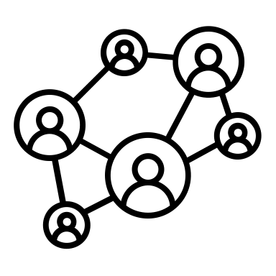

Building DL models - workflow
Get data
Explore & Clean data
Preprocess data
Construct DL model
Train model
Test/Validate model
Improve
DL model
(Learns from input data)
Clustering
Classification
Pattern recognition
Insight
Predictions
Forecasts
Input
Output
“Start by articulating the problem; What do you want to predict”
Monitor the performance of the algorithm

Slide 12
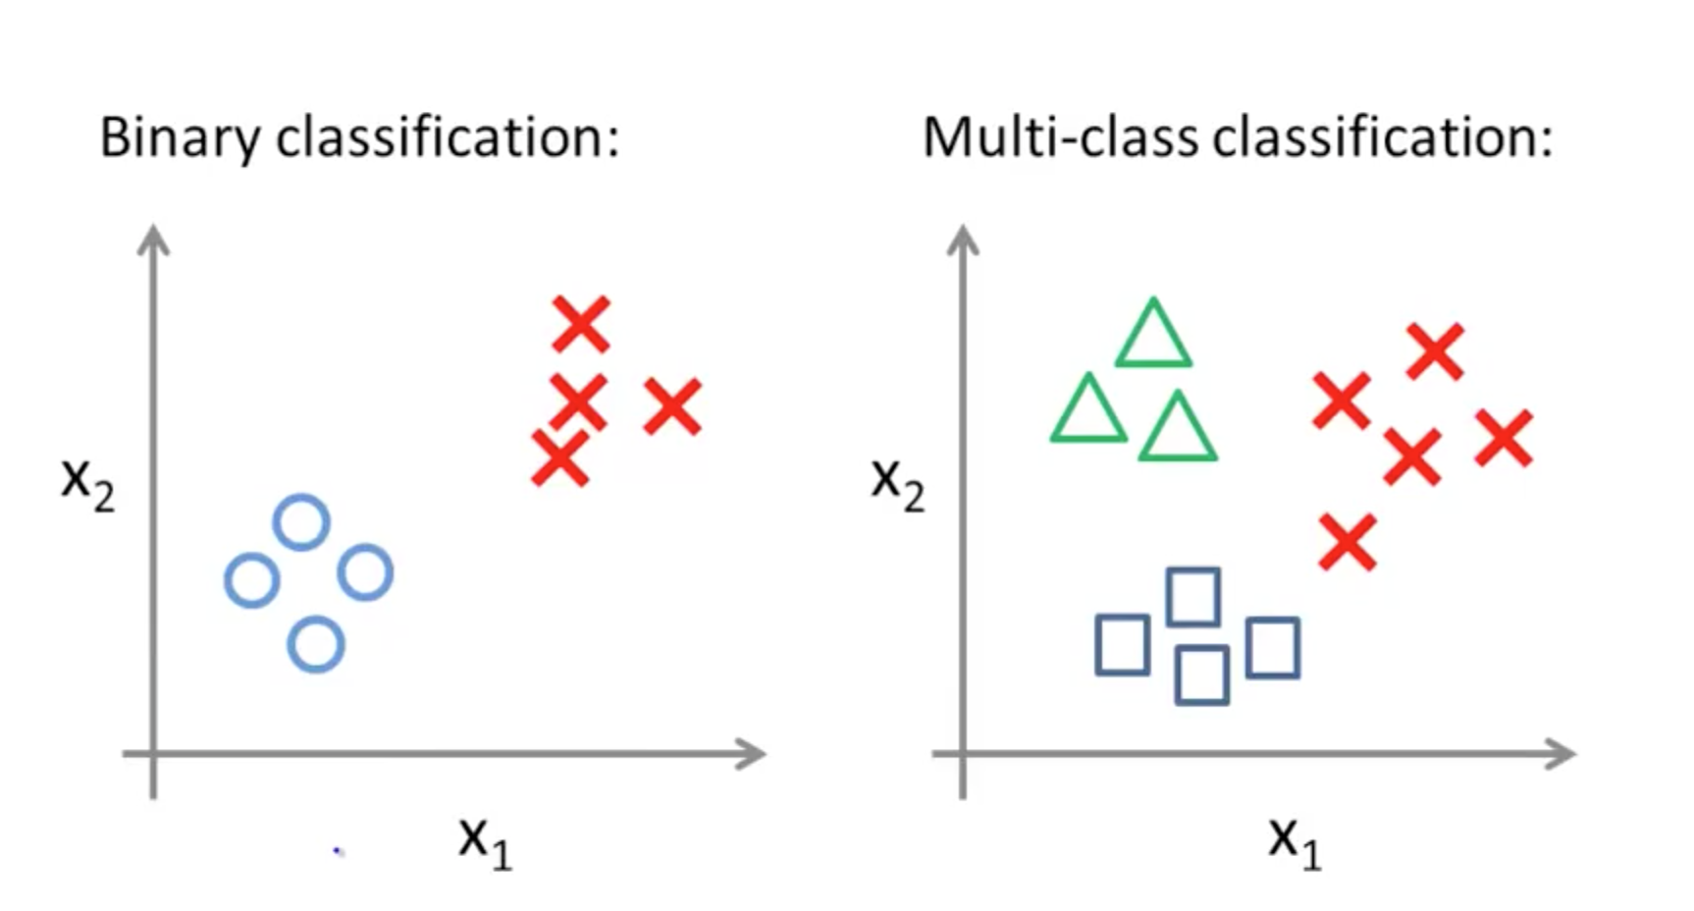
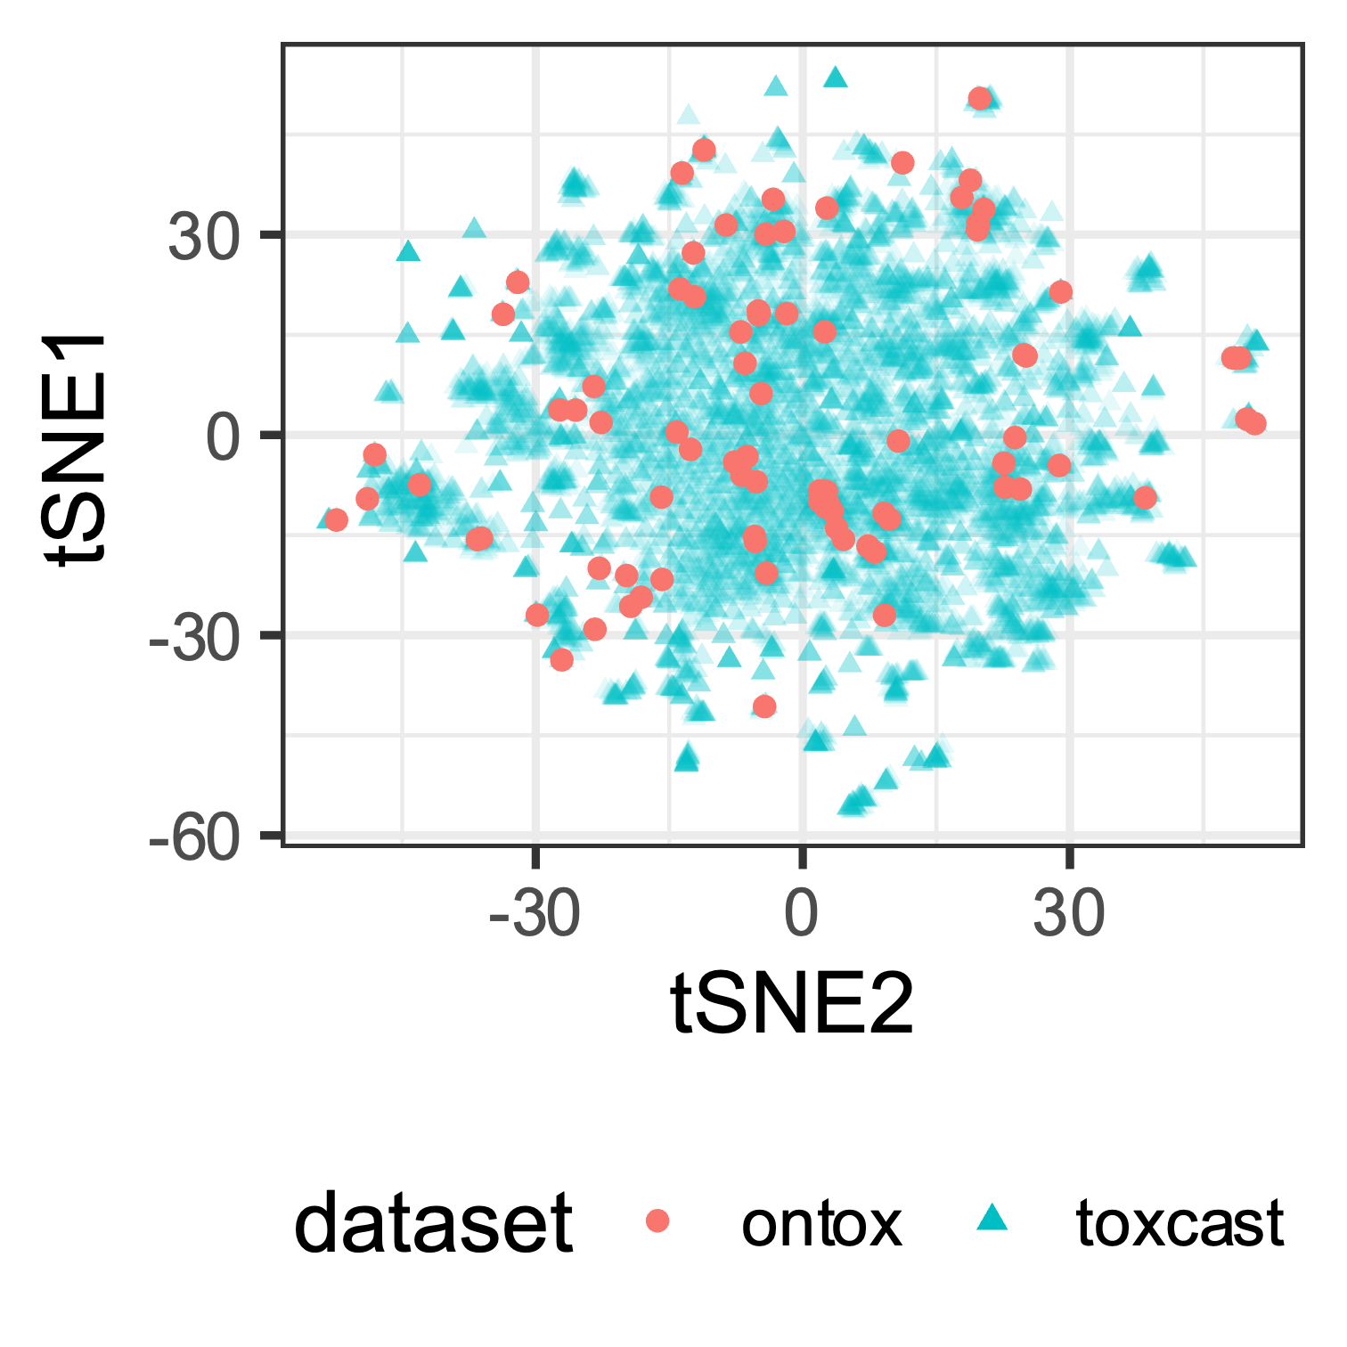
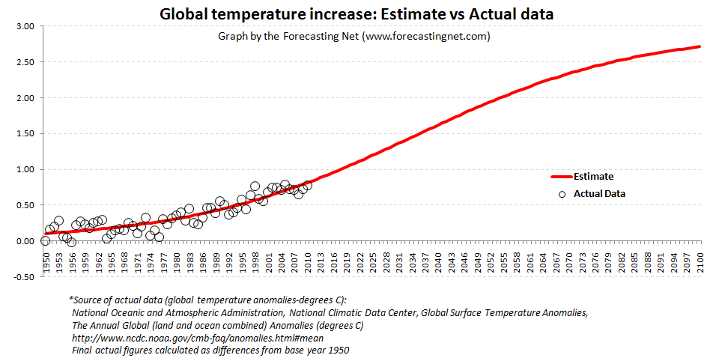
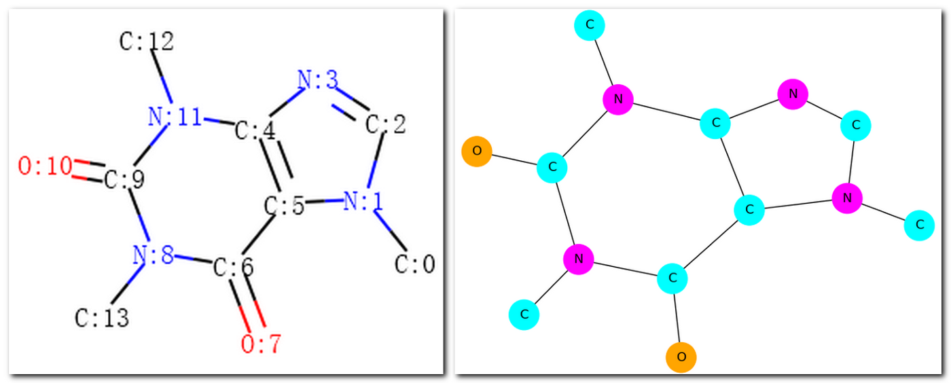
Articulate the problem
Classification
Needs labelled data
Binary vs Multi-class
ML and DL methods
Clustering
Unlabeled data
ML and DL methods
Rank
List of ranked objects
ML and DL methods
Graph
Fragments and structures
Graph embeddings
DL methods
Regression
Numeric output
ML and DL methods
Time series, forcasting
Notes:
First and foremost, the most important questions to ask are (1) “what are you attempting to solve for?” (2) “What is the desired outcome?”
However, we must continuously remind ourselves that AI cannot be the panacea in itself. It’s a tool, not the entire solution itself. There are several techniques and many different problems to solve with AI.
Think about this analogy that helps to explain the above. If you want to cook a tasty dish you have to know exactly what you are going to cook and all the ingredients that you need.

Slide 13
Start with Exploratory Data Analysis & use code to do it.
For robustness, traceability and reproducibility:
Applying the 7 principles of Guerilla Analytics is highly desirable.
Principle 1: Space is cheap, confusion is expensive
Principle 2: Prefer simple, visual project structures and conventions
Principle 3: Prefer automation with program code
Principle 4: Maintain a link between data on the file system, data in the analytics environment, and data in work products
Principle 5: Version control changes to data and analytics code
Principle 6: Consolidate team knowledge in version-controlled builds
Principle 7: Prefer analytics code that runs from start to finish
Check data quality, exploratory data analysis
Subset data
Clean data
Feature engineering
Enrich data from external sources
Investigate effects of imputation
Explore patterns with inferential statistics
Prepare data for analysis -> transform data to tensors
EDA = Exploratory Data Analysis, see for tips in R:
https://bookdown.org/rdpeng/exdata/ by Roger Peng
https://guerrilla-analytics.net/the-principles/

Slide 14
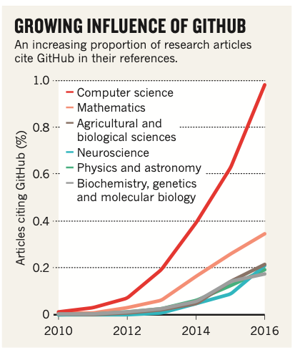
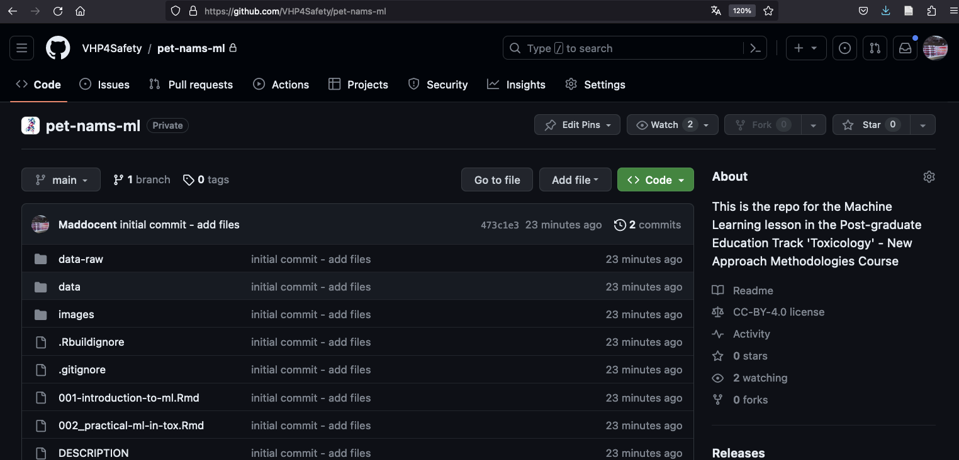
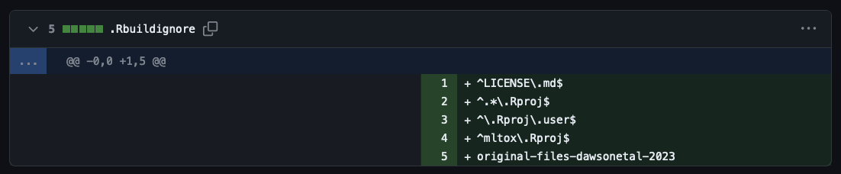
Github (or any version control) is essential
Perkel, J. Democratic databases: science on GitHub. Nature 538, 127–128 (2016). https://doi.org/10.1038/538127a

Slide 15
Input data for Deep Learning models - Tensors -

Slide 16
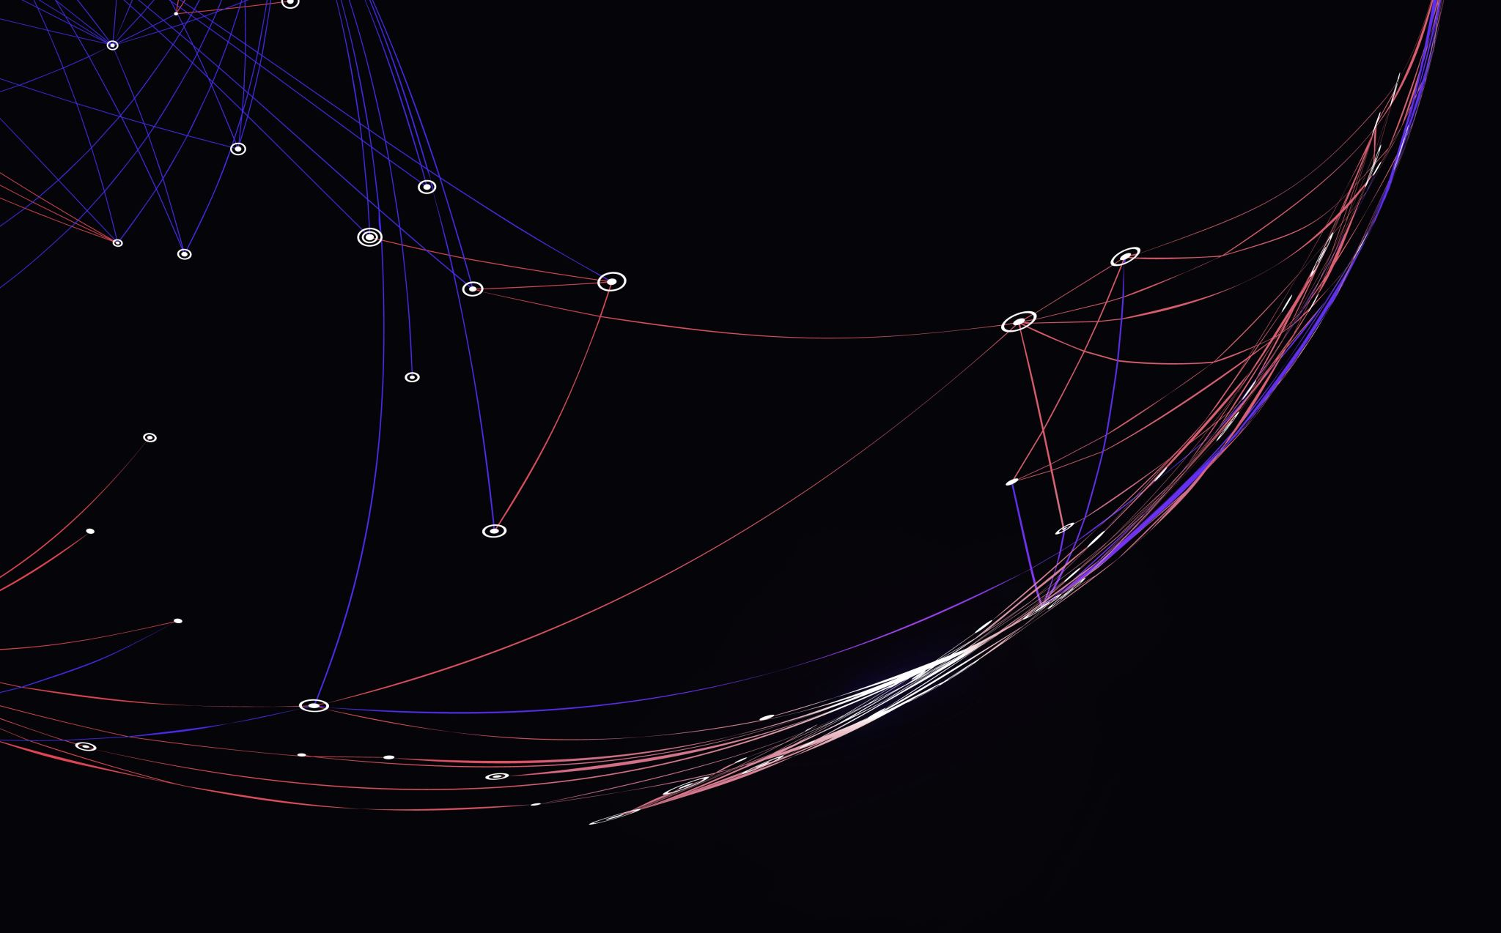
Tensors as input for neural networks
Tensors are generalizations of vectors, that function as input for ML algorithms.
Let’s look at some examples

Slide 17
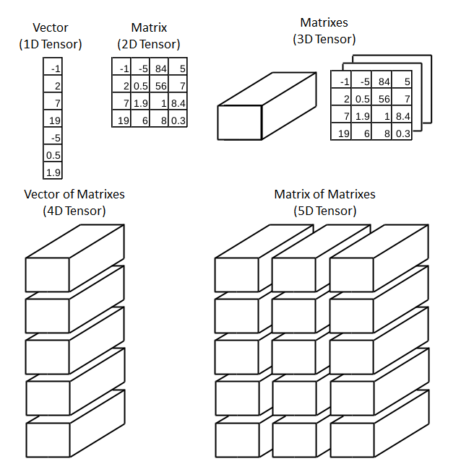
Tensors
1D Tensor: No real-world data
2D Tensor: Vector data
(samples, features)
3D Tensor: Time series or sequence
(samples, timesteps, features)
4D Tensor: Images (samples, height, width, channels) or (samples, channels, height, width)
5D Tensor: Video (samples, frames, height, width, channels)
https://towardsdatascience.com/deep-learning-introduction-to-tensors-tensorflow-36ce3663528f

Slide 18
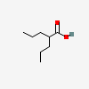
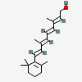
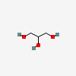
Toxicology example
Machine learning algorithm
?
compound | Hazard_dart
VPA | 1
RA | 1
GL | 0
Valproic acid
Retinoic acid
1. How can we transform compound structure to tensors that can be fed into a DL network?
2. How can the compounds be meaningfully represented to generate rules about the outcome?
Glycerol
Valproic acid
Notes:
If we assume a one-on-one relationship between structure of a compound and whether a compound is toxic or not (and we know this is not the case in real life) we can think of data-representations for ‘compound structure’ that are informative
We won’t be doing something that is this complicated in this lecture and there are multiple ways to generate meaningful representations of molecular structures that can be learned by Deep Learning network. One of them is graph convolutions, of which I will speak shortly later in the presentation. For now, we move to Rstudio where I can show you more hands-on how we can generate tensors from molecule SMILES. We are not going to actually build a DL network to do any compound classifications, due to time constrictions. But I will demonstrate how to build a DL model to recognize handwritten digits using the famous MNIST dataset.

Slide 19
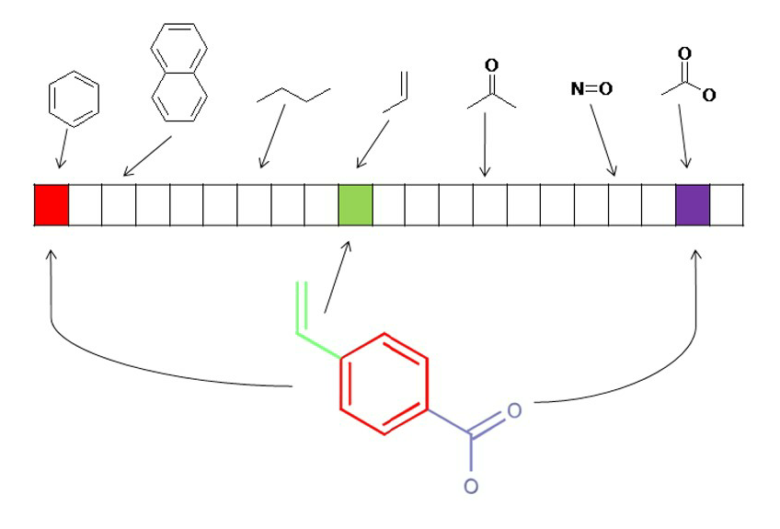
Molecular fingerprints (Bit-encoding)
100000000100000000010

Slide 20
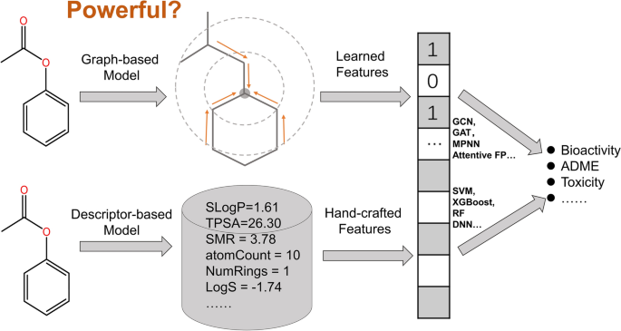
A new solution: Graph Neural Networks (GCN)
https://neptune.ai/blog/graph-neural-network-and-some-of-gnn-applications
https://jcheminf.biomedcentral.com/articles/10.1186/s13321-020-00479-8

Slide 21
RDKit mol structure vs NetworkX graph
Molecule structures can be represented as graphs

Slide 22
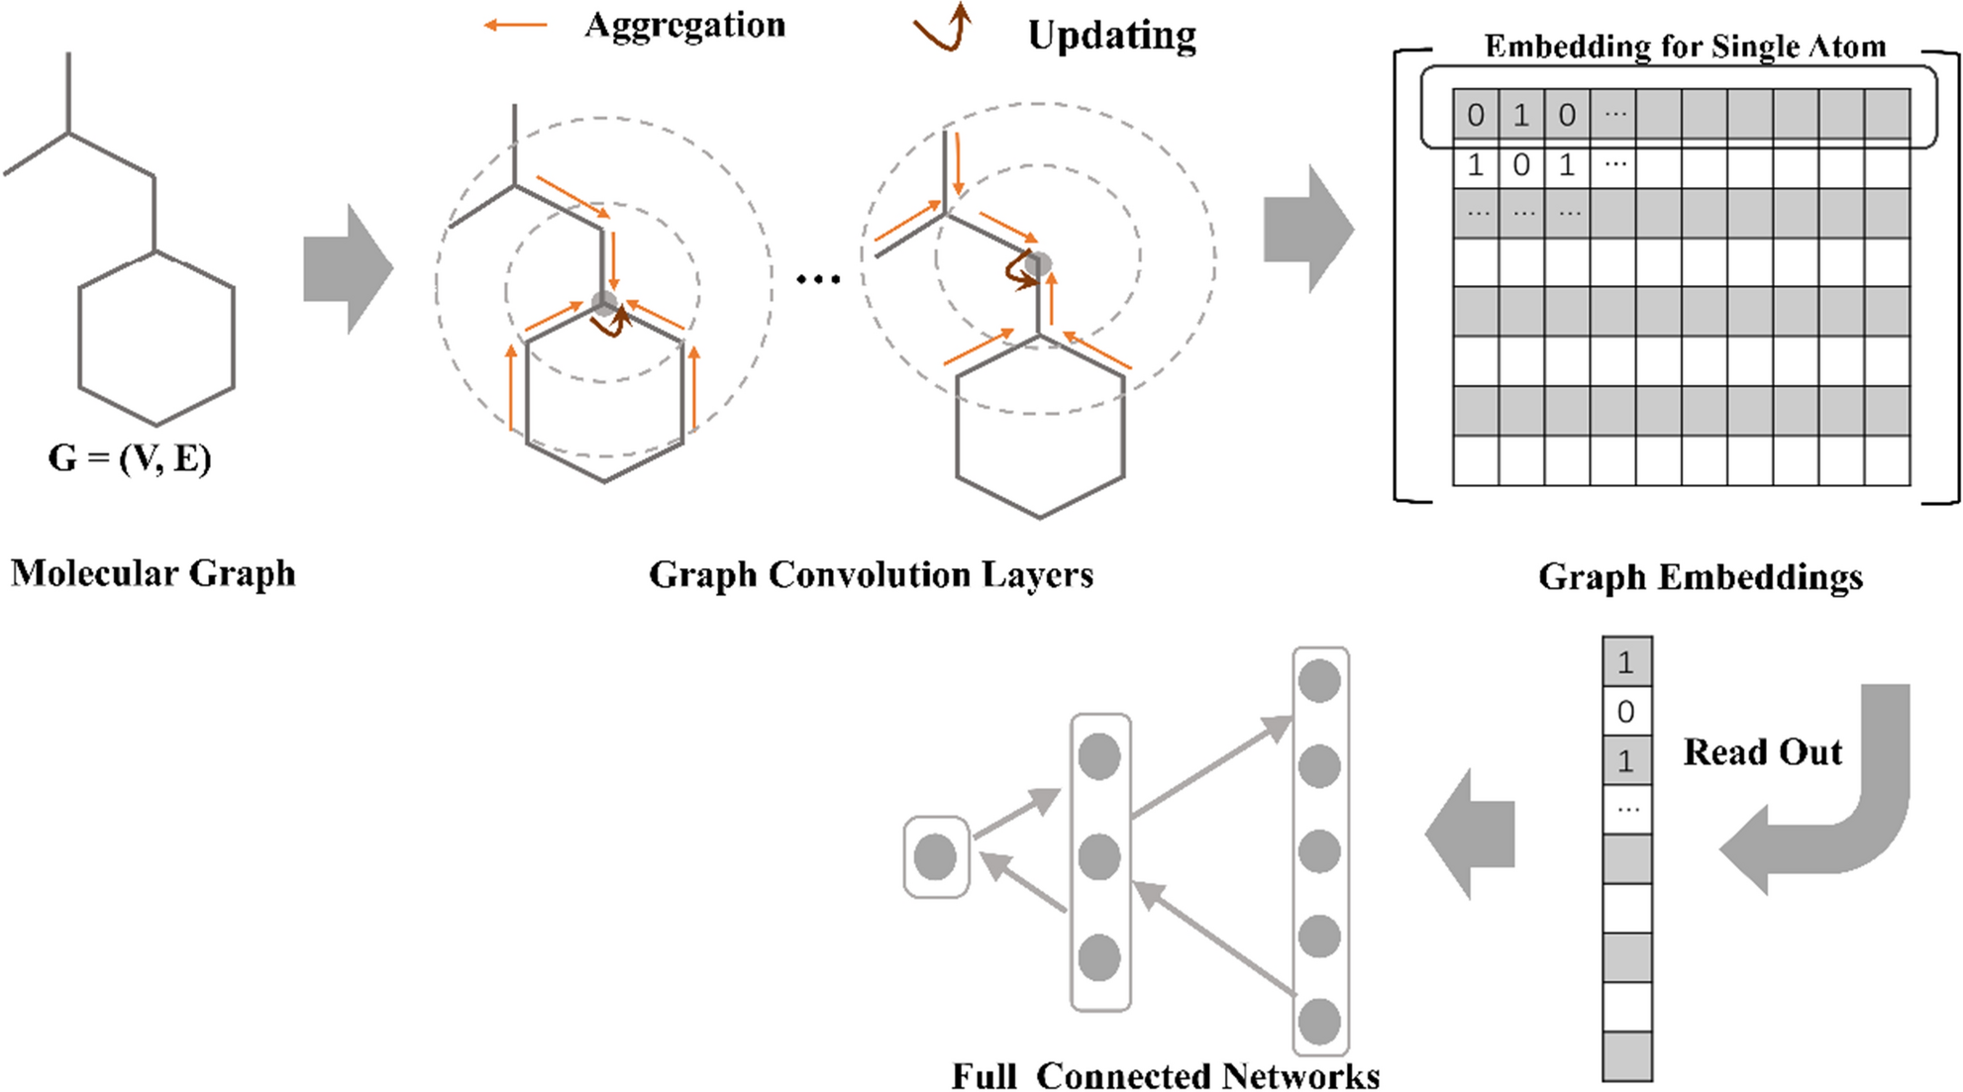
Graph representation of molecules
https://neptune.ai/blog/graph-neural-network-and-some-of-gnn-applications
https://jcheminf.biomedcentral.com/articles/10.1186/s13321-020-00479-8

Slide 23
Choosing the right model

Slide 24
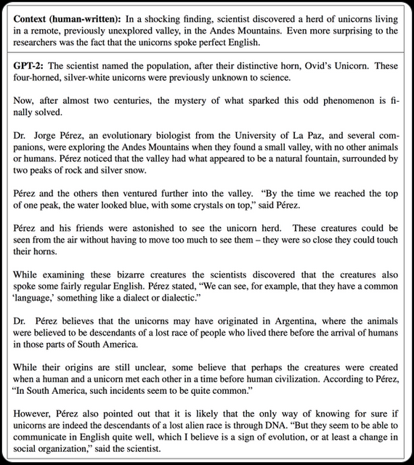

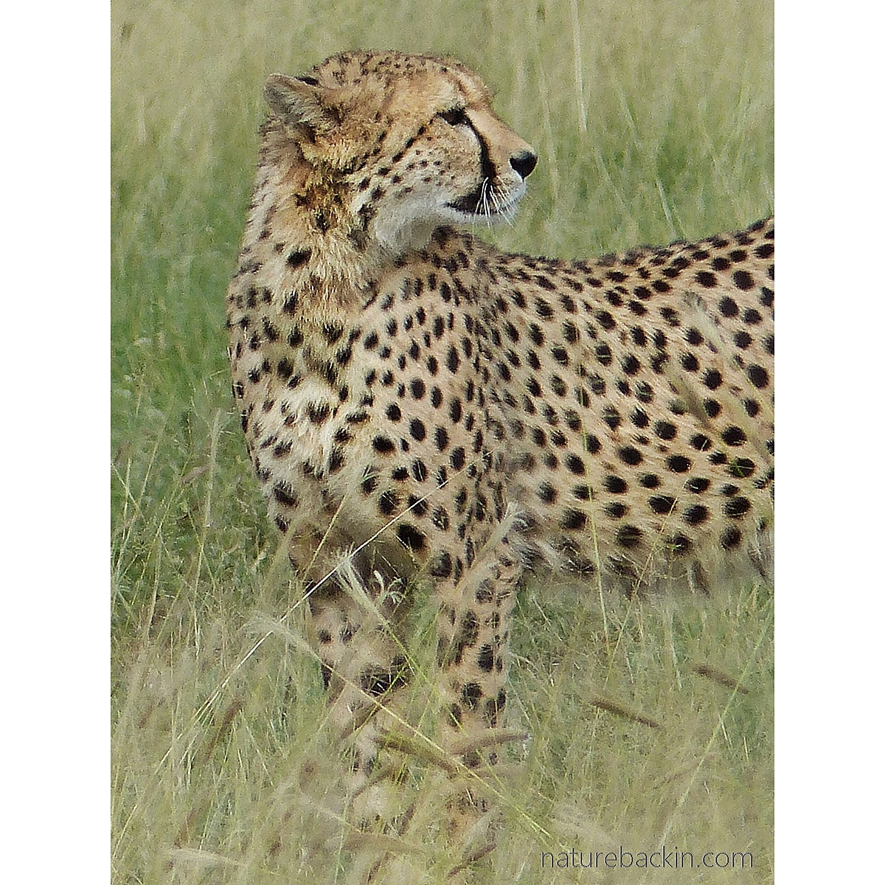
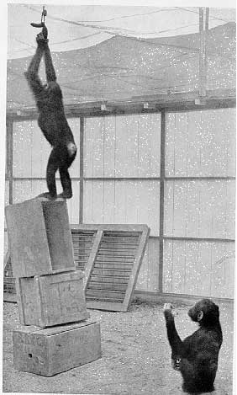

Type of learning/task
Generative AI
Supervised active learning
Pattern recognition /
Classification / Correlation
Problem solving / Transfer learning
Reinforcement learning
Notes:
While Wolfgang Kohler was interned at Tenerife, he devoted his energy to the study of Chimpanzees and their cognitive abilities. This picture is taken during one of the classical experiments where Kohler studied problem solving capacities. We see on the picture Grande’s attempts to reach to the treat hanging from the ceiling.

Slide 25
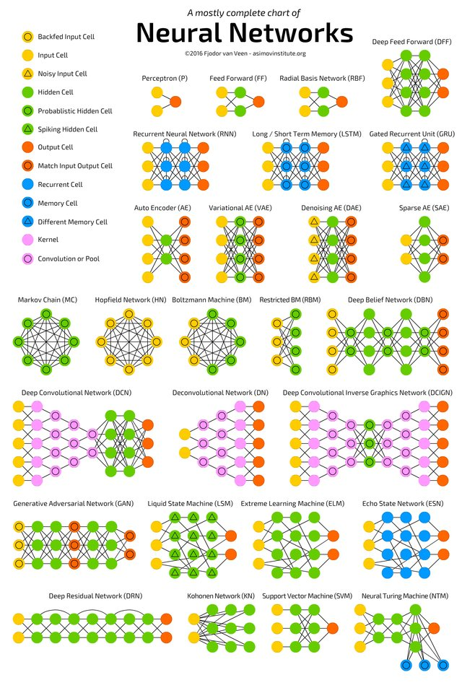
Choosing a model
Select model for the task
Start simple
Experiment with the topology or model flavour
Consolidate team knowledge
Use data partitioning or K-fold cross validation
Run with simulations of the data
Compare methods/models to compare performance
Tune hyperpramters

Slide 26
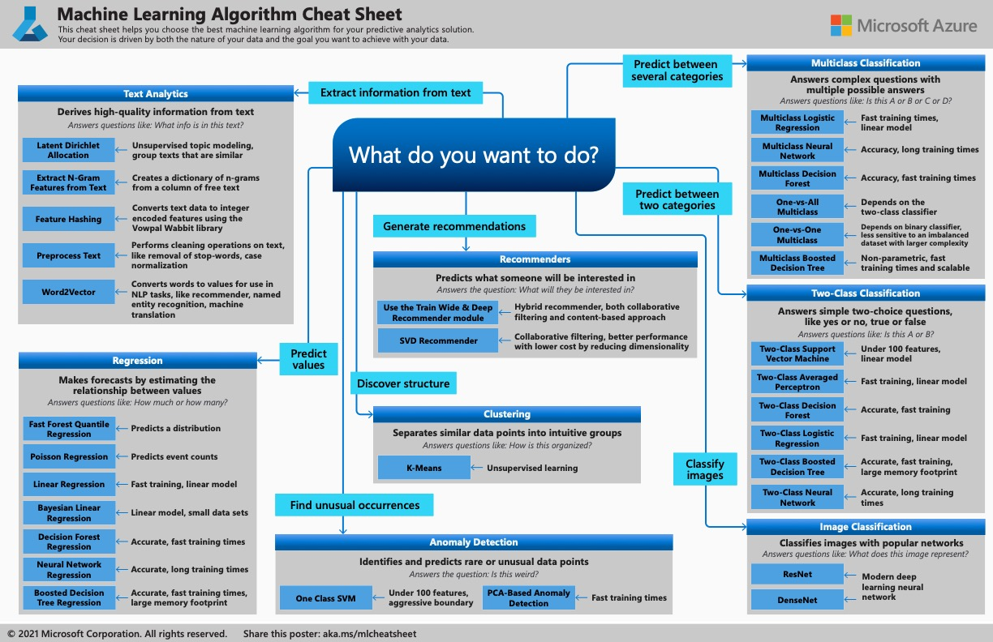

Slide 27
AI examples in Toxicology

Slide 28
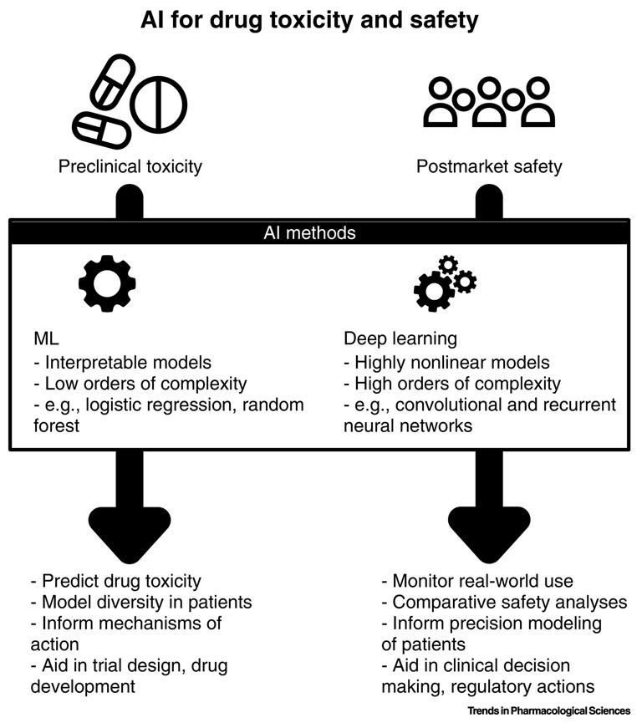
AI in drug toxicity & safety
https://pubmed.ncbi.nlm.nih.gov/31383376/#&gid=article-figures&pid=figure-1-uid-0
https://dx.doi.org/10.1016%2Fj.tips.2019.07.005

Slide 29
Data in toxicology
Structured
Tox. Databases
In vitro data (e.g. dose-response / omics)
In vivo data
Network data (e.g. AOP wiki, Reactome etc.)
Chemicals
Images
Video
Unstructured
Scientific Literature
Free text in databases
Internet
Tox21 Machine Learning Data Set
http://bioinf.jku.at/research/DeepTox/tox21.html

Slide 30
Application of AI in toxicology
Structure Activity Relationships (Q)SAR) / (RA)SAR
Post marketing surveillance
Data extraction and generation insight using NLP
Probabilistic risk assessment
Basile, A. O., Yahi, A., & Tatonetti, N. P. (2019). Artificial Intelligence for Drug Toxicity and Safety. Trends in pharmacological sciences, 40(9), 624–635. https://doi.org/10.1016/j.tips.2019.07.005

Slide 31
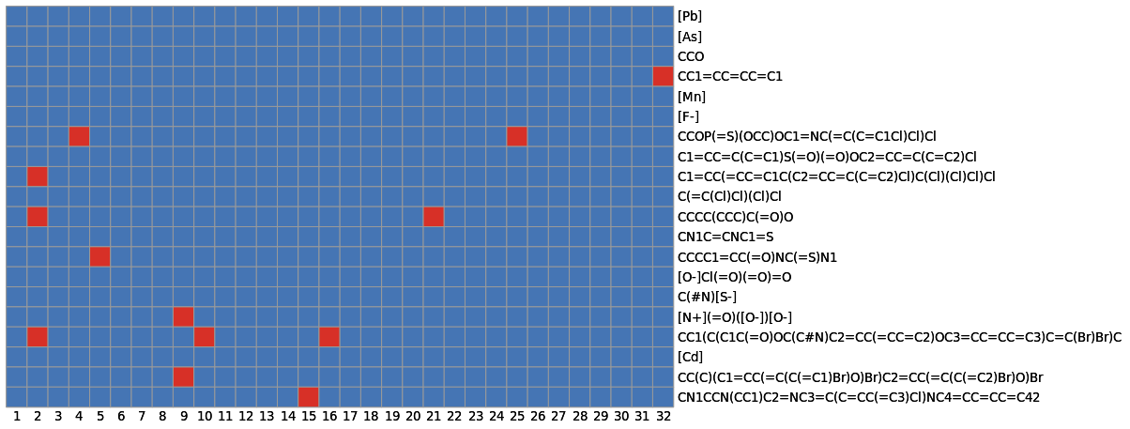
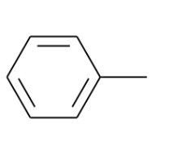
QSAR and friends
Molecular fingerprint (substructures)
Physico-chemical characterstics (Xlog, AlogP, N_atoms, N_{C}, N_{N}, N_{H}, N_{O} etc.
Biological activity
In vitro assays
In vivo data
Clinical data
Notes:
AlogP: partitioning coefficient
XlogP:

Slide 32
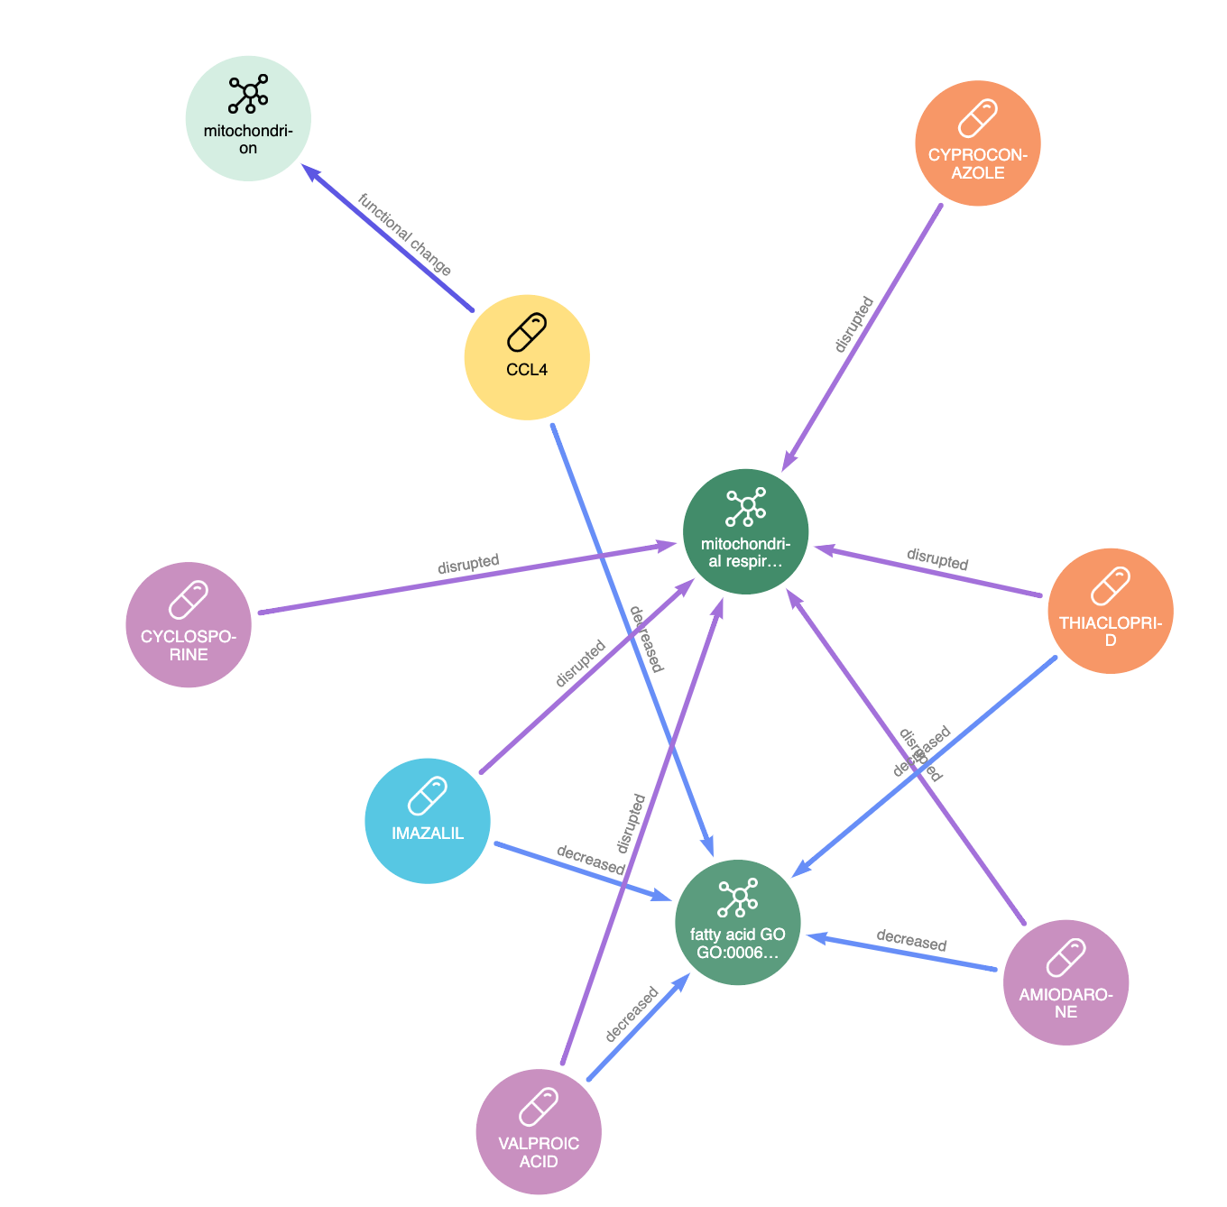
RASAR: Read Across SAR
Luechtefeld, T., Marsh, D., & Hartung, T. (2019). Missing the Difference Between Big Data and Artificial Intelligence in RASAR Versus Traditional QSAR. Toxicological sciences : an official journal of the Society of Toxicology, 167(1), 4–5. https://doi.org/10.1093/toxsci/kfy287
Input data:
Structure of molecules
Physico-chemical properties
Toxicological hazard classifications
Similarity
Output: hazard prediction based on similar compounds, taking into account all input data
Improvement: e.g. Graph Convolutional representation of the molecular structure
... The published model uses data on 100 000+ chemical structures, calculates 5 billion+ similarities, and simultaneously makes 190 000 predictions for nine hazards of toxic properties of chemicals ...

Slide 33
Where to start?

Slide 34








Programming languages / frameworks
Statistics
Machine Learning
Deep Learning
Visualization
Bioinformatics
Statistics
Machine Learning
Deep Learning
Visualization
Bioinformatics
Natural Language Processing
Chem-informatics (RDKit)
Graph Database
Graph Visualization
Graph Algorithms

Slide 35
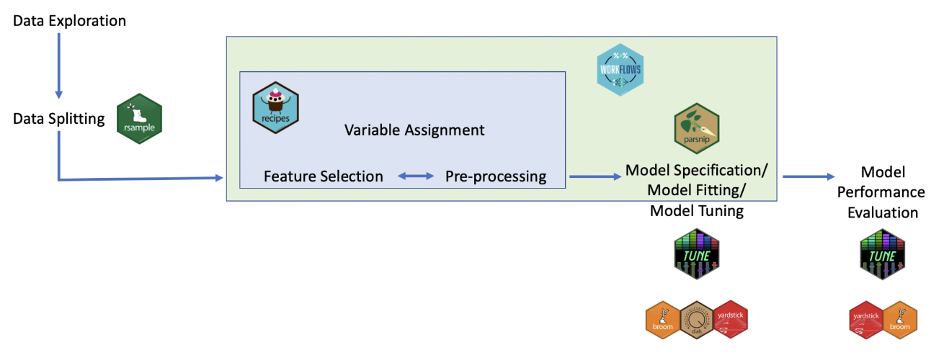
Tidymodels (hands on example)
Split data
Model specification
Recipe (algorithm, engine, task, data, predictors)
Workflow (model specs + recipe)
Tune
Fit
Test
Evaluate

Slide 36

Posit cloud: <add workspace-link>

